Slide 1
Revaluations and impairment testing of non-current assets
ACC5AAI
Notes:
Example title for notes and handouts
Example footer for notes and handouts
This is the Presentation Title page. Type over the existing content to add your title and subtitle.
This page uses the slide master for the Heading page.
It is recommended that you always include the date of your presentation in the subtitle.

Slide 2
REFERENCES
Deegan, C, 2010, Australian Financial Accounting, Chapter 6
  AASB 116 Property, Plant and Equipment
  2. AASB 138 Intangible Assets
  3. AASB 136 Impairment of Assets

Slide 3
Objectives of this lecture
Understand how and when to revalue an item of property, plant and equipment in accordance with AASB 116
Understand the difference in accounting treatments for upward revaluations to ‘fair value’, as opposed to write-downs to ‘recoverable amount’
Understand what an ‘impairment loss’ is and know how to account for one
Example presentation title Page <number>
Notes:
Example title for notes and handouts
Example footer for notes and handouts
This slide uses the Title and text slide layout.
Add a title by clicking on the title box
Add information into the bulleted list area by typing the text, and pressing RETURN to create new bullets. The look of the bullets and the text is defined by the design template.
To indent your bullet points press the <tab> key.
To change the footer information Select View / Header and Footer and replace “Example presentation title” with your title and press apply all.

Slide 4
Relevant accounting standards
There are three standards of particular relevance
  AASB 116 Property, Plant and Equipment
  2. AASB 138 Intangible Assets
  3. AASB 136 Impairment of Assets
Example presentation title Page <number>
Notes:
Example title for notes and handouts
Example footer for notes and handouts
This slide uses the Title and text slide layout.
Add a title by clicking on the title box
Add information into the bulleted list area by typing the text, and pressing RETURN to create new bullets. The look of the bullets and the text is defined by the design template.
To indent your bullet points press the <tab> key.
To change the footer information Select View / Header and Footer and replace “Example presentation title” with your title and press apply all.

Slide 5
Introduction to revaluations
Why? Historical cost…
In Australia, entities may revalue many non-current assets
  However, AASB 138 specifically excludes the revaluation of some intangible assets
Asset revaluations—what are they?
  Recognising a reassessment of the carrying amount of a non-current asset to fair value
  Excludes recoverable amount write-downs (i.e. impairment losses)

Slide 6
Introduction to impairment losses
If a non-current asset’s carrying amount exceeds its recoverable amount it must be written down to its recoverable amount (AASB 136)
  The write-down is called an impairment loss (not to be confused with a revaluation)
  Carrying amount: cost of asset (or revalued amount) less accumulated depreciation and impairment losses thereon
  Recoverable amount: higher of an asset’s fair value less costs to sell, and value in use

Slide 7
Introduction to impairment losses cont.
  Fair value, less costs to sell (or net selling price): amount obtained from the sale of an asset in an arm’s length transaction between knowledgeable, willing parties less the costs of disposal
  Value in use: present value of the future cash flows expected to be derived from an asset

Slide 8
Consider ‘external’ and ‘internal’ sources of information. (AASB136.12)
Are there indications that an asset may be impaired? (AASB136.9)
No
Yes
Higher of Fair Value Less Costs To Sell and Value In Use (AASB136.6)
Do nothing
Estimate Recoverable Amount (AASB138.18)
Is Recoverable Amount less than Carrying Amount? (AASB138.59)
No
Yes
Difference = Impairment Loss (AASB136.60)

Slide 9
Impairment losses
Best understood by looking at some examples
Example 1-Simple
Example 2-With discounting to derive value in use

Slide 10
Impairment-Example 1
Wallabies Ltd has machinery and equipment which it purchased on 1/1/X8 for $80,000. It has a useful life of 10 years with no residual value. On 31/12/X8 its recoverable amount (higher of fair value or value in use) is estimated to be $70,000. Record the journal entries.
Depreciation=80.000/10=8,000
Carrying Amount 80,000-dep 8,000=72,000
Recoverable amount=70,000
Therefore impairment expense CV>RA=2,000

Slide 11
Illustration of Cost Method
1/1/X8 Dr Machinery and Equipment 80,000
Cr Bank 80,000
31/12/X8 Dr Dep’n Mach and Equip’t 8,000
Cr Accum Dep’n Mach and Equip’t 8,000
31/12/X8 Dr Impairment Loss 2,000
Cr Accumulated Impairment 2,000

Slide 12
Illustration of Cost Model
The Statement of Comprehensive Income will show in ‘profit or loss section’
Depreciation exp. $8,000
Impairment loss
/expense $2,000
The Balance Sheet will show:
Machinery $80,000
Less Acc Dep $8,000
Less Acc impairment loss $2,000
Carrying Amount $70,000
(Note: Acc Dep and Acc Imp can be combined into one line to read ‘Accumulated Depreciation
and Impairment’ $10,000

Slide 13
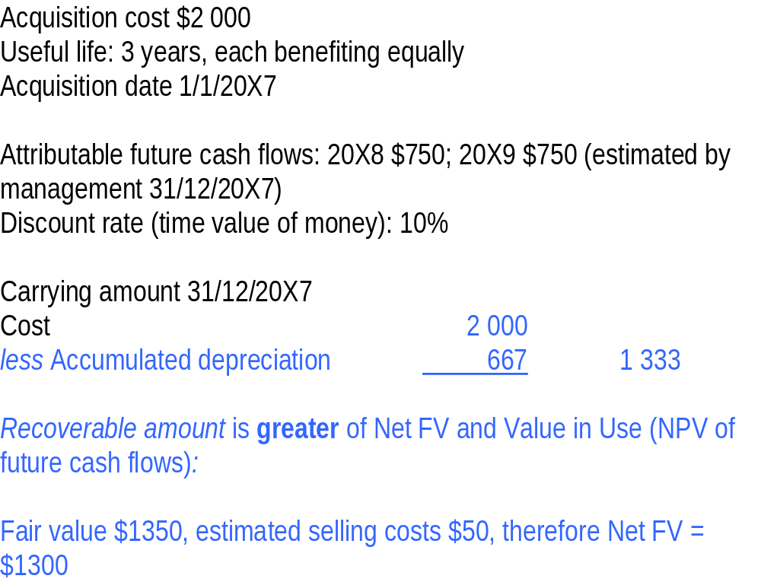
Impairment-Example 2

Slide 14
Value In Use (NPV of future cash flows)
Assumptions
:
discount rate
10
%
, all cash flows occur end relevant period
Date
Expected
Discount factor
=
cash flow
1/(1+i)
n
(
i
= .10)
PV
31/12/20X8
750
0.90909
681.82
31/12/20X9
750
0.82645
619.84
1
301.66
Rec
o
verable amount is $
1
30
2
(rounded to nearest dollar)

Slide 15
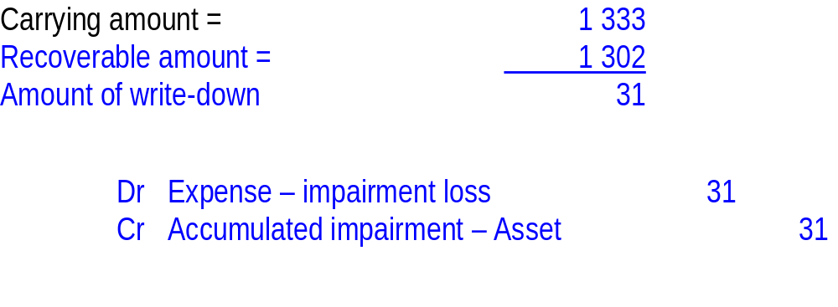

Slide 16
Impairment losses
Impairment losses can be reversed in subsequent periods (unless a particular accounting standard prohibits it—eg. intangible assets)
Worked Example 6.1 (p. 199) provides an example of a reversal of an impairment loss
Impairment losses will at times be determined by reference to a ‘cash-generating unit’ rather than to a specific asset.
AASB 136 defines a cash-generating unit as ‘the smallest identifiable group of assets that generates cash inflows that are largely independent of the cash inflows from other assets or groups of assets’
See Worked Example 6.4 (p. 202)—Accounting for an impairment loss by reference to a cash-generating unit

Slide 17
Example 3 (6.4)—Impairment loss by reference to a cash-generating unit
Ulladulla Ltd has a printing process comprising four separate but highly interdependent assets. The printing machinery has a combined carrying value of $1 000 000, made up as follows:
Asset 1 $100 000
Asset 2 $200 000
Asset 3 $300 000
Asset 4 $400 000
$1 000 000
It was determined that the value in use of the cash-generating unit, which is calculated at its present value, amounted to $800 000
The current fair value less costs to sell of the entire unit is $750 000

Slide 18
Example 3—Soln.
The total impairment loss will therefore be equal to $1 000 000 less the greater of the value in use and fair value less costs to sell
This gives us a total impairment loss of $200 000. The impairment loss would be apportioned across the four assets based on carrying values
  For example, the allocation of the impairment loss to Asset 4 would be 400 000 divided by 1 000 000 multiplied by 200 000. This would equal $80 000

Slide 19
Solution Cont.
Hence the accounting entry to record the impairment loss on the cash-generating unit would be:
Dr Impairment loss 200 000
Cr Accum. impairment losses—Asset 1 20 000
Cr Accum. impairment losses—Asset 2 40 000
Cr Accum. impairment losses—Asset 3 60 000
Cr Accum. impairment losses—Asset 4 80 000

Slide 20
PPE at cost or fair value?
AASB 116 requires each class of property, plant and equipment to be measured at either cost or fair value
  Examples of classes are land and buildings, machinery and motor vehicles
Some classes might be measured at cost and others at fair value
With a mix of measurement methods, is the total balance of non-current assets meaningful?
Entities may switch from fair value to cost for justifiable reasons and provided adequate disclosures are made (AASB 116)

Slide 21
PPE at cost or fair value? Cont.
Where an entity changes from the ‘cost model’ to fair value (the ‘revaluation model’) for a class of non-current assets and there was a previous impairment loss (AASB 116):
  any increase in an asset’s carrying amount is first recognised as income; and
  any excess above the amount if no impairment loss had previously been recognised is transferred to a revaluation surplus account/reserve

Slide 22
PPE at cost or fair value? Cont.
If a class of non-current assets is measured at cost, AASB 136 is to be applied:
  if an asset’s carrying amount is greater than its recoverable amount, an ‘impairment loss’ must be recognised
  this would not constitute a revaluation

Slide 23
Revision-Buzz
If an asset’s carrying amount is impaired, AASB 116 requires all assets in the same class to be revalued.
A: True
B: False
If an asset is subject to depreciation or amortization there is no longer a need to test the asset for impairment.
A: True
B: False
An entity that elects the revaluation model to measure a class of asset, is permitted to revert back to the cost model provided that this will provide more relevant and reliable information.
A: True
B: False
The revaluation model is a tool used by managers to reduce political costs.
A: True
B: False

Slide 24
Use of fair values
Any revaluation of non-current assets must be to fair value (AASB 116)
Fair value is the amount for which an asset could be exchanged between knowledgeable, willing parties in an arm’s length transaction
Fair value is determined on the assumption that the entity is a going concern
Market price is to be used where an active and liquid market exists for the asset

Slide 25
Use of fair values cont.
Revaluations must be made with sufficient regularity so the carrying amount of each asset in the class does not differ materially from its fair value (AASB 116)
If values change regularly and changes are material, revaluations might be necessary each reporting period
Otherwise every three to five years is sufficient

Slide 26
Revaluation increments
General procedure (AASB 116)
  Debit Asset
  Credit Revaluation surplus
The revaluation surplus is part of shareholders’ funds (owners’ equity)
Directors may approve cash distributions to shareholders from the revaluation surplus but they must exercise extreme caution

Slide 27
Revaluation & accm. depreciation
If a revalued asset is a depreciable asset, any balance of accumulated depreciation is credited to the asset account prior to revaluation (AASB 116)
Journal entry (net-amount method)
  Dr Accumulated depreciation
  Cr Asset
  Dr Asset
  Cr Revaluation surplus
Refer to Worked Example 6.5 (p. 205)—Revaluation of a depreciable asset using the net-amount method
Subsequent depreciation is to be based on the revalued amount of the asset

Slide 28
Example 4 (6.5)—Revaluation of a depreciable asset using the net-amount method
As at 1 July 2011, Farrelly Ltd has an item of machinery that originally cost $40 000 and has accumulated depreciation of $15 000. Its remaining life is assessed to be five years, after which time it will have no residual value. Farrelly decided on 1 July 2011 that the item should be revalued to its current fair value, which was assessed as $45 000.

Slide 29
Example 4—Revaluation of a depreciable asset using the net-amount method-Soln
The total revaluation increment will represent the difference between the carrying amount and the fair value. In this case it would be:
$45 000 – ($40 000 – $15 000) = $20 000
The journal entries on 1 July 2011 would be:
Dr Acc. depreciation—machinery 15 000
Cr Machinery 15 000
Dr Machinery 20 000
Cr Revaluation surplus 20 000

Slide 30
Example 5—Revaluation increment
A building with a cost of $400 000 and accumulated depreciation of $190 000 is revalued to its fair value of $350 000
What are the journal entries?
  Dr Accm. depreciation 190 000
  Cr Building 190 000
  Dr Building 140 000
  Cr Revaluation surplus 140 000
Net effect-Building =$350,000

Slide 31
Accm. depreciation on revaluation (cont.)
Alternative method (AASB 116)
  Accumulated depreciation may be restated proportionately with the change in gross carrying amount of the asset, so the carrying amount after revaluation equals the revalued amount
  This is referred to as the gross method
Refer to Worked Example 6.6 (p. 205)

Slide 32
Revaluation decrements
In line with the concept of conservatism, revaluation decrements are recognised as an expense in the statement of comprehensive income

Slide 33
Example 6—Revaluation decrement
Refer to the previous example, except this time the fair value of the building (acquired for $400 000 and having accumulated depreciation of $190 000) is $150 000 rather than $350 000
What are the journal entries?
  Dr Accumulated depreciation 190 000
  Cr Building 190 000
  Dr Loss on reval. of building 60 000
  Cr Building 60 000

Slide 34
Reversal of revaluation decrements and increments
For an asset class, reversals of previous revaluations should be recorded by the reverse of the initial revaluation entries
If a revaluation decrement reverses a previous increment for the same asset, then the entries are:
Dr Accumulated depreciation
Cr Asset
Dr Revaluation surplus
Dr Loss on revaluation (the excess, if any)
Cr Asset

Slide 35
Example 7- reversal of a previous revaluation increment (p. 207)
PK Ltd acquires a block of land on 1 January 2010 for $200 000 in cash
Due to increased housing demand in the area, the land has a market value of $290 000 on 1 January 2011
However, the market value falls to $140 000 on 30 June 2013

Slide 36
Example of a reversal of a previous revaluation increment -Soln
1 January 2010
Dr Land 200 000
Cr Cash 200 000
1 January 2011
Dr Land 90 000
Cr Revaluation surplus 90 000
30 June 2013
Dr Revaluation surplus 90 000
Dr Loss on revaluation of land 60 000
Cr Land 150 000

Slide 37
Decrements and increments (cont.)
If a revaluation increment reverses a previous decrement for the same asset:
Dr Asset
Cr Gain on revaluation
Cr Revaluation surplus (the excess if any)

Slide 38
Disposal of assets
Gain or loss from derecognition of an item of property, plant and equipment is to be calculated as the difference between (AASB 116):
  net disposal proceeds (if any), and
  the asset’s carrying amount
Derecognition is:
  the point in time when an asset is removed from the statement of financial position (balance sheet)
  when an asset is sold, or
  when no future economic benefits are expected from an asset’s use or disposal
Refer to Worked Examples 6.9, 6.10 and 6.11on pages 208–211

Slide 39
Disposal cont.
When an asset is sold, any resulting balance in the revaluation surplus (AASB 116):
  may be transferred directly to retained earnings
  cannot be transferred to the profit or loss
If a non-current asset is revalued upwards, any gain on sale will be less than the gain if the asset had not previously been revalued
Refer to Worked Examples 6.9, 6.10 and 6.11on pages 208–211

Slide 40
Consideration of present values
Recoverable amount is the higher of an asset’s net selling price and its value in use (AASB 136)
Value in use (AASB 136) is:
  the present value of the future cash flows expected from an asset
Estimating value in use (AASB 136) involves:
  estimating future cash inflows and outflows from the continued use and subsequent disposal of the asset; and
  applying the appropriate discount rate to future cash flows
Discounting future cash flows will decrease the calculated recoverable amount

Slide 41
Increments and decrements within a class of assets?
Increments and decrements may be offset only to the extent that they relate to a particular asset (AASB 116)
- Therefore, if say one item of land increased in fair value by $10 million and another item of land decreased in fair value by $1 million (and assuming no prior revaluations), then a loss of $1 million would be recognised in profit or loss for the period but the $10 million would be shown as part of ‘other comprehensive income’
  Do you think this is ‘sensible’?

Slide 42
Economic consequences
If contracts in place are tied to reported profits (debt or management compensation), management might have an incentive not to revalue
  Why?
Other implications?
  if assets are increased?
Firms subject to “political” scrutiny?
  Given the proposed mining tax, ceteris paribus, what is a miner likely to do?

Slide 43
Summary
This lecture considered the revaluation of non-current assets, with the emphasis on property, plant and equipment
If the recoverable amount is below the carrying amount, an impairment loss should be recorded
For upwards revaluations:
  assets are to be revalued to fair value
  any increase is to be transferred to a revaluation surplus, unless it is a reversal
For downwards revaluations:
  any decrease is to be treated as an expense, unless it is a reversal

Slide 44
Summary cont.
When a revaluation is undertaken:
  any existing accumulated depreciation should be credited against the non-current asset (if the net method is used – which is the common approach), and
  the non-current asset should be increased by the amount of the revaluation
Where a revalued asset is sold, the gain or loss is the difference between the carrying amount and the net disposal proceeds of the asset
We also discussed wider economic consequences of revaluations

Slide 45
Revision
1. Purple Co Ltd purchased an item of land 3 years ago at a cost of $700 000. Two years ago the recoverable value of the land was considered to be $550 000. In the current period the land is revalued and the fair value is now $750 000. What is the treatment of the change in value in each of the periods?
A. Two years ago: A loss of $150 000 is recognised. The current period: A gain of $150 000 and an increase in the asset revaluation reserve of $50 000 is recognised.
B. Two years ago: $150 000 is debited to the asset revaluation reserve. The current period: $200 000 is credited to the asset revaluation reserve.
C. Two years ago: $150 000 is expensed in the period. The current period: $200 000 is transferred to the asset revaluation reserve.
D. Two years ago: $150 000 is written off to the asset revaluation reserve. The current period: $200 000 revenue is recognised.
E. None of the given answers.

Slide 46
Revision
2. Once a class of non-current assets has been revalued, AASB 116 requires that:
A. Directors continue to revalue the class of assets on an ad hoc basis.
B. Revaluations must be undertaken regularly enough to ensure that the carrying amount of each asset in the class of assets does not differ materially from its fair value at reporting date.
C. All assets in the class must be revalued every 3 years.
D. Revaluations must be undertaken regularly enough to ensure that the carrying amount of the class of assets does not differ from its fair value at reporting date.
E. None of the given answers.

Slide 47
Revision
3. Brahms Ltd acquired a property of land and building for $1.5 million. Management estimates the value of land to be 40% of cost. The building is estimated to have a useful life of 50 years. After 25 years, the property was revalued at 1.2 million. It is expected that the life of building will remain the same and salvage value is expected to be $100,000. What is the revaluation gain(loss) for building and the depreciation expense one year after revaluation?
A: $120,000; $24,800
B: ($120,000); $28,800
C: $220,000; $24,800
D: ($220,000); $28,800
E: None of the given answers

